Slide 1
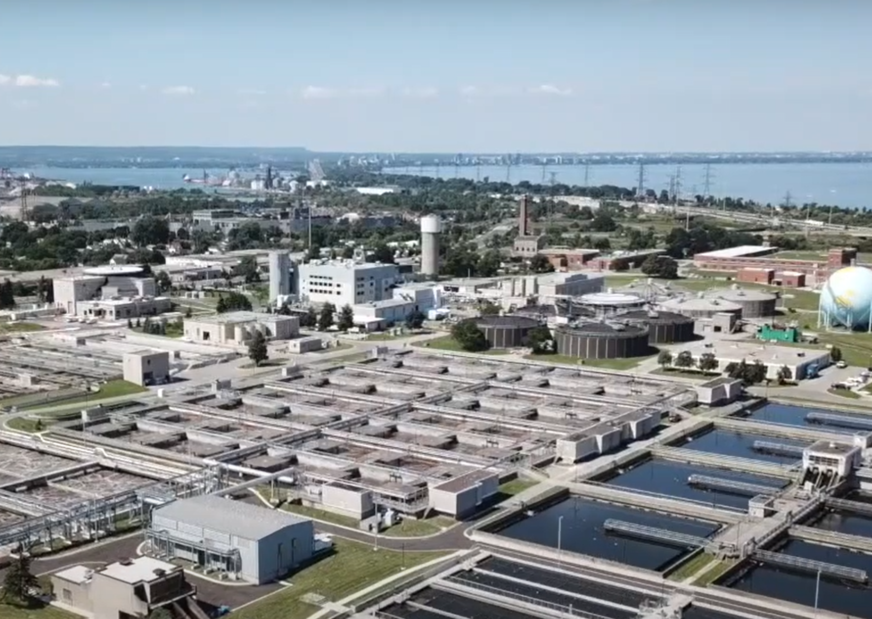
SyncMaster
A cloud-based user authentication and document distribution system for the City of Hamilton, Water Division
Akshit Gulia
Kyle D’Souza
Mitchell Hynes
Richard Fan
Rafeed Iqbal
Notes:
Hi everyone, We’re Akshit, Kyle, Richard, and Rafeed, and Mitchell from team 15 and pleased to present our project SyncMaster with you all.

Slide 2
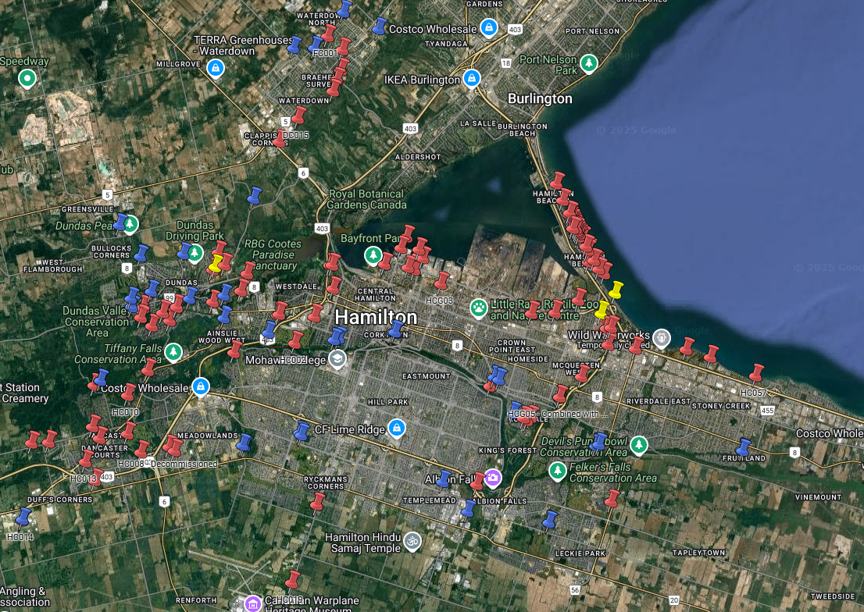
Our Stakeholder
City of Hamilton’s Water Division, Plant Maintenance and Technical Services team
Maintains 100+ pumping stations throughout the City of Hamilton
Notes:
Our industry stakeholder for our project is the Technical Services team within the City of Hamilton’s Water Division. Hamilton Water is responsible for the treatment and distribution of drinking water and wastewater. To accomplish this, there are over 100 pumping stations located all throughout the City of Hamilton. The Technical Services team is responsible for the maintenance of these stations and manages over 30 different service contracts for this task. This includes contracts for HVAC, plumbing, masonry, roofing, and many more.

Slide 3
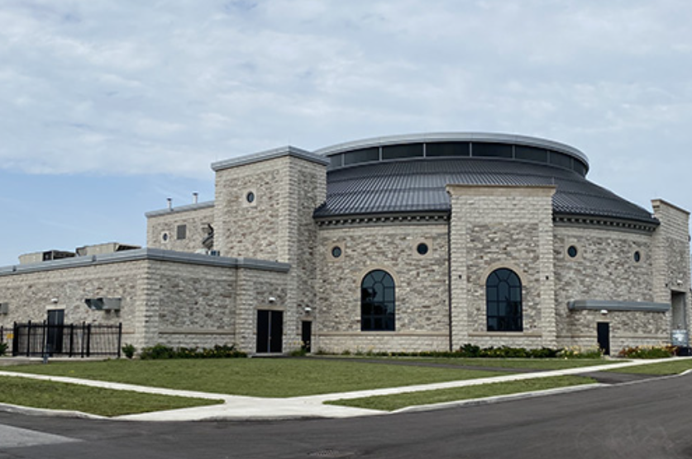
Current Challenges
Lack of visibility on contractors at sites
Difficulty updating and redistributing station documentation
Manually performing tasks causing a strain on team resources
Notes:
However, this is not a simple feat. The Technical Services team is small, and their current processes are extremely manual and proving to create gaps in compliance with City policies.
There are two major responsibilities the Technical Services team wishes to accomplish:
The team needs to be aware of when their contractors are visiting stations to know if their work is being completed as they say it is. Currently, they have to either manually drive to the site, or persistently email or phone the contractors for updates on work. It would greatly improve productivity if this could be automated in some respect.
The team is responsible for informing contractors of any health and safety hazards present on site, and providing them with corresponding documentation and having a record of the contractors acknowledging these hazards. Currently, this is also an extremely manual process with poor visibility.
Our project was to work with the City to develop an application to accomplish both of these tasks: track the visits of contractors and distribute documentation and collect acknowledgements.

Slide 4



Why Not Other Products?
File hosting systems: Can’t integrate views specific to sites with user authentication
City policy dictates that no external parties can access their network
Capstone is the perfect environment to explore a tailored solution

Slide 5
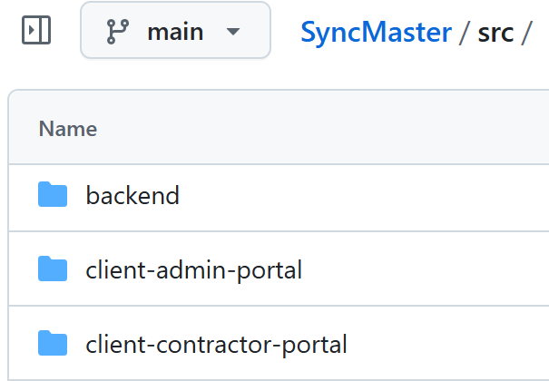
Admin Portal
View site visit logs and upload documentation, “syncing” the two portals
Contractor Portal
Acknowledge documentation and explain purpose of visit
Now, let’s see it in action!
Notes:
The solution we devised was to create an application with two portals, called the contractor portal and the admin portal, respectively.
Each of the pumping stations has its own contractor portal which the contractor accesses by scanning a QR code physically located at the station. This prompts them to read and acknowledge any documentation specific to that station and state the purpose of their visit.
The admin portal is used by the technical services team to view contractor site visit logs, manage user accounts, and upload station documents which displays in the contractor portal.
Now, we will demonstrate the portals!

Slide 6


Evolution of Requirements
Removed integration into the City’s SharePoint
Changing the tracking of jobs to individual site visits
Added and then subsequently removed visitor account feature, favouring trusted access
Refine Figma design
Present to City for feedback
Notes:
The project requirements evolved substantially over the course of the project as our understanding of the challenge was refined.
Initially, we planned to integrate the file sharing directly with the City’s sharepoint, allowing files to be managed with existing tools. However, this was scrapped upon learning the City policy does not allow any external actors directly into a City network system. Our system now had to be standalone.
We realized that a single work order could have many separate site visits, and it would be convenient if they could be connected in some way. However, we realized this was an instance of scope creep, as the City will have a dedicated work order management system some day and we wanted no duplication with that system. We cut it back to the core problem: verifying individual site visits.
In practice, many contractors frequently come and go. The idea of a visitor account was to simplify the process of adding contractors to the system. However, it was not possible to protect the visitor account in a way which would be effortless and prevent any member of the public form accessing files and uploading files to the system.

Slide 7


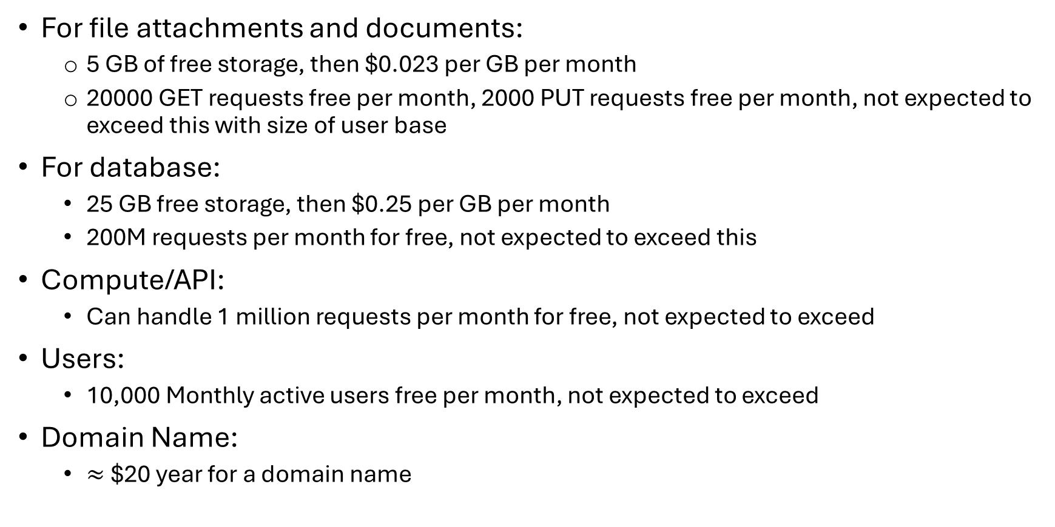
Costs
For file attachments and documents:
5 GB of free storage, then $0.023 per GB per month
20000 GET requests free per month, 2000 PUT requests free per month, not expected to exceed this with size of user base
For database:
25 GB free storage, then $0.25 per GB per month
200M requests per month for free, not expected to exceed this
Compute/API:
Can handle 1 million requests per month for free, not expected to exceed
Users:
10,000 Monthly active users free per month, not expected to exceed
Domain Name:
$≈$$20 year for a domain name

Slide 8


Usability and Portability
Performed usability testing with our primary stakeholder, receiving a score of 10/10 for comfort of using the system, discovery of features, and smoothness of the experience.
Application works effectively on mobile and desktop browsers.

Slide 9

Maintainability
Code is commented, have linters running to ensure consistent formatting, using Renovate to search for security vulnerabilities in dependencies
All AWS infrastructure is easily deployable, using Infrastructure as code
Follows design mentioned in design document
We have 95% line coverage and 90% branch coverage on our code

Slide 10
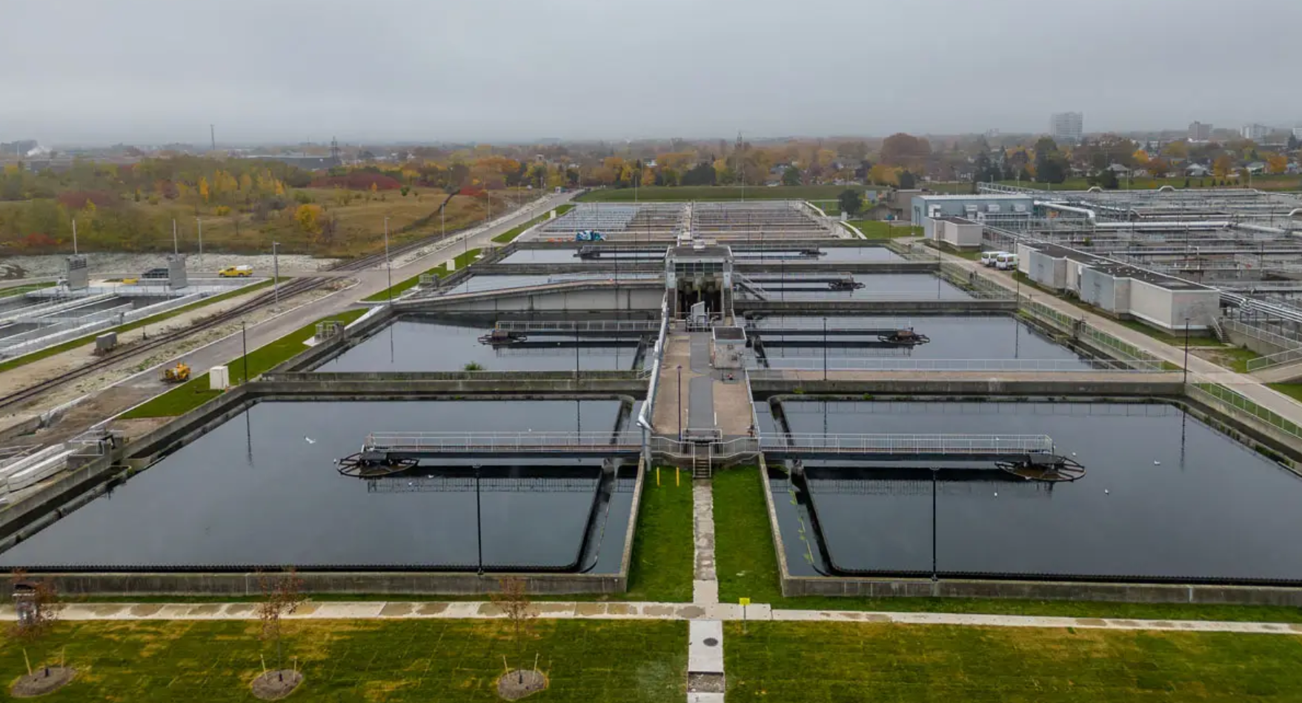
Thank You!

